Slide 1
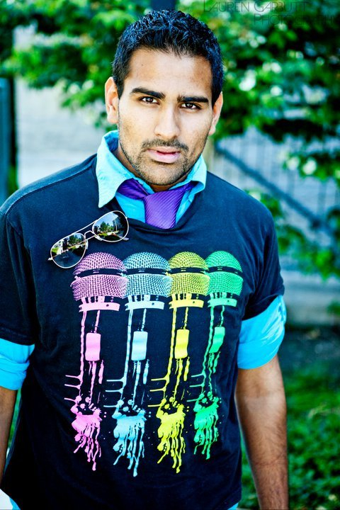
Joshua s. D’cunha
BIOGRAPHY

Slide 2
Roles
Actor
Singer
Songwriter
Model
Visual Artist
Graphic Artist
Employment Facilitator
Community Relations Coordinator
Marketing and Advertising Coordinator

Slide 3
Born in Scarborough, ON
Raised in St. Catharines, ON
Attended St. Christopher Elementary School
Graduated from Denis Morris Secondary School
Attended Red River College and currently enrolled at Niagara College for Pre Media and Design

Slide 4
Denis Morris Catholic High School
Accomplishments
Lead Role in Aida : Radames
Lead Role in Les Miserables: Javert
Denis Morris Idol Finalist

